Slide 1
Machine Translation

Slide 2
Sequence to sequence models
These types of problems, where you put some text into your model and get some other text out of it, are known as sequence to sequence or string transduction problems.
The general task of sequence to sequence modelling is at the heart of some of the most difficult tasks in NLP, including:
Text summarization
Text simplification
Question answering
Chatbots
Machine translation

Slide 3
Machine Translation (MT)
Machine translation is the task of automatically converting source text in one language to text in another language.
Given a sequence of text in a source language, there is no one single best translation of that text to another language. This is because of the natural ambiguity and flexibility of human language

Slide 4
Machine Translation
Statistical Machine Translation
use of statistical models that learn to translate text from a source language to a target language gives a large corpus of examples.
The approach is data-driven, requiring only a corpus of examples with both source and target language text. This means linguists are not longer required to specify the rules of translation.
Neural Machine Translation
Neural machine translation, or NMT for short, is the use of neural network models to learn a statistical model for machine translation.
The key benefit to the approach is that a single system can be trained directly on source and target text, no longer requiring the pipeline of specialized systems used in statistical machine learning.

Slide 5
Evaluating Machine Translation
French: Le chat est sur le tapis
Reference 1: The cat is on the mat. (Translation by human)
Reference 2: There is a cat on the mat. (Translation by another human)
Multiple translations possible.
One of the challenges of machine translation is that how to evaluate a machine translation system quality/accuracy.
Bleu Score: A method for automatically evaluation of machine translation
BLEU was originally developed to measure machine translation

Slide 6
Evaluating Machine Translation
How can I assign a single numerical score to this translation that tells us how “good” it is using only the provided reference sentences and the neural output?
Why do you need a single numerical score?
If we want to use machine learning to build a machine translation system we need a single real number score to put into our loss function.

Slide 7
Bleu Score
BLEU, stands for Bilingual Evaluation, Understudy. (senior actor)
Score is an understudy, could be a substitute for having humans evaluate every output of a machine translation system.
Given by Kishore Papineni, Salim Roukos, Todd Ward, and Wei-Jing Zhu.

Slide 8
Bleu Score
Look at each word in the output sentence
Assign it a score of 1 if it shows up in any of the reference sentences
Assign 0 if it doesn’t.
To normalize that count so that it’s always between 0 and 1, you can divide the number of words that showed up in one of the reference translations by the total number of words in the output sentence.
This gives us a measure called unigram precision.

Slide 9
Bleu Score on unigram
French: Le chat est sur le tapis
Reference 1: The cat is on the mat. (Translation by human)
Reference 2: There is a cat on the mat. (Translation by another human)
MT Output: The the the the the the the.
Word: The
Precision: 7/7 the appears in both references /count of unigram
Modified Precision:2/7 max times word appeared in sentences/count unigram
Words precision are counted individually
Blue score: word as well as pairs (bigram, trigram)

Slide 10
Bleu Score on bigram
French: Le chat est sur le tapis
Reference 1: The cat is on the mat. (Translation by human)
Reference 2: There is a cat on the mat. (Translation by another human)
MT Output: The cat the cat on the mat.
Bigrams: Count: Count clip(max count in ref):
the cat: 2 1
cat the: 1 0
cat on: 1 1
on the: 1 1
the mat: 1 1
modified precision: sum of count clip/total bigram words=4/6

Slide 11
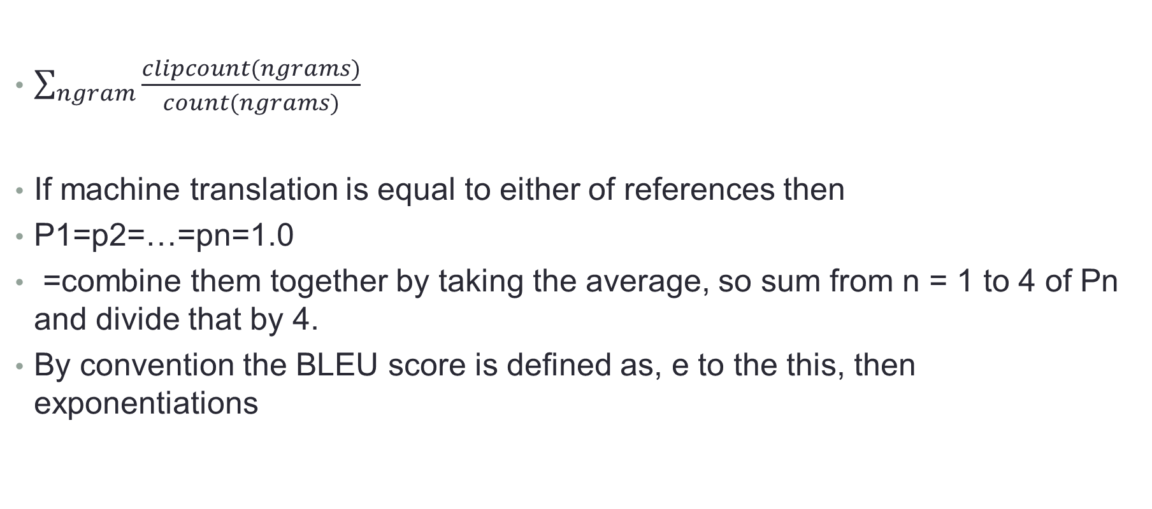
Blue Score on ngrams
$\sum_{ngram}{\frac{clipcount(ngrams)}{count(ngrams)}}$
If machine translation is equal to either of references then
P1=p2=…=pn=1.0
=combine them together by taking the average, so sum from n = 1 to 4 of Pn and divide that by 4.
By convention the BLEU score is defined as, e to the this, then exponentiations

Slide 12
Brevity Penalty
If we translate very short sentences there is easier to get high precision
One way of getting around this is by multiplying the score we have so far by a measure that penalizes sentences that are shorter than any of our reference translations. We can do this by comparing it to the length of the reference sentence that it the closest in length. This is the brevity penalty.
If our output is as long or longer than any reference sentence, the penalty is 1. Since we’re multiplying our score by it, that doesn’t change the final output.
BP = { 1 if MT_output_length>reference_output_length
exp(1-MT_output_lenght/reference_output_length) otherwise

Slide 13
BLEU Strengths and Drawbacks
Strengths:
It’s fast and easy to calculate, especially compared to having human translators rate model output.
It’s ubiquitous. This makes it easy to compare your model to benchmarks on the same task.
Drawbacks:
It doesn’t consider meaning
It doesn’t directly consider sentence structure
It doesn’t handle morphologically(smallest unit like s in cats) rich languages well
It doesn’t map well to human judgments

